Slide 1
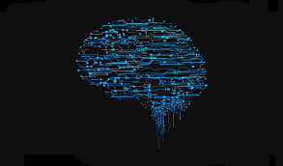
Deep Learning

Slide 2
Definition of Artificial Neural Network
Artificial Neural Network (ANNs) are programs designed to solve any problem by trying to mimic the structure and the function of our nervous system

Slide 3
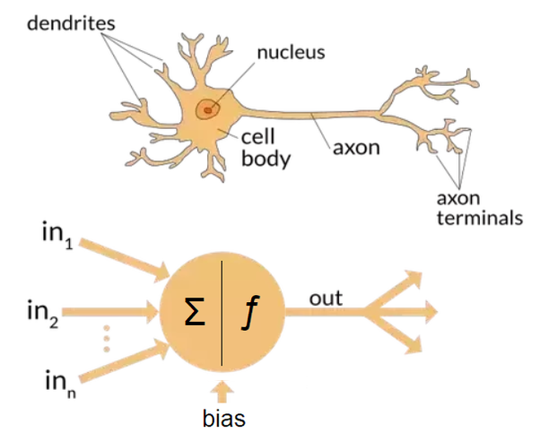
Biological Model of the Human Neuron

Slide 4
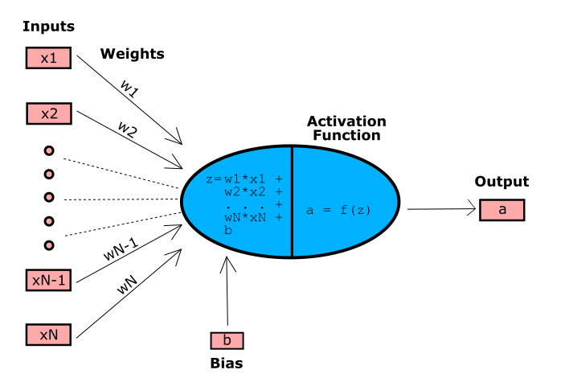
Neuron

Slide 5
General Terminologies
Weight
Weight determines how much the current input/feature affects the output.
The machine finds the weight through the training process.
Thus it is a parameter
Bias
Bias is a constant which helps the model in way that it can fit best for the given data. Bias is a constant which gives freedom to perform best.

Slide 6
Types of neural networks
Perceptron
Feed Forward Neural Networks
Convolutional Neural Networks
Recurrent Neural Networks
Long Short Term Memory(LSTM) Networks

Slide 7
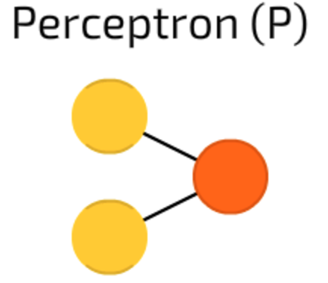
Simplest and oldest model of neuron
Takes input, sums them up and apply activation function

Slide 8
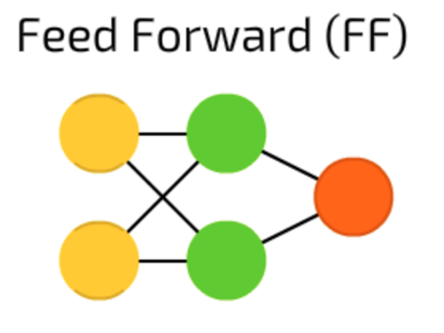
All nodes are fully connected
Activation flows from input layer to output without backpropagation
Hidden layer between input and output layer
Hidden layer may be one or multiple

Slide 9
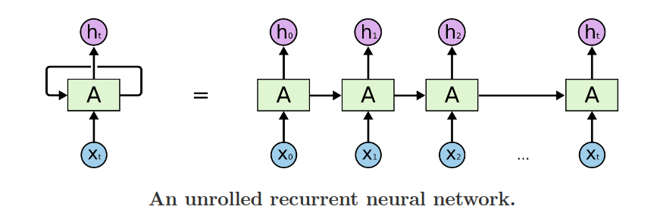
Recurrent Neural Network
Networks with loops
Allow information to persist
Multiple copies of same network

Slide 10
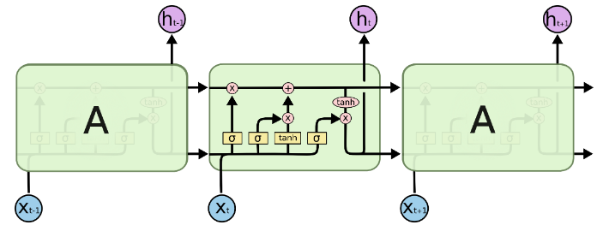
Long Short Term Memory (LSTM) Networks
Similar to RNN
Solve long term dependency problem

Slide 11
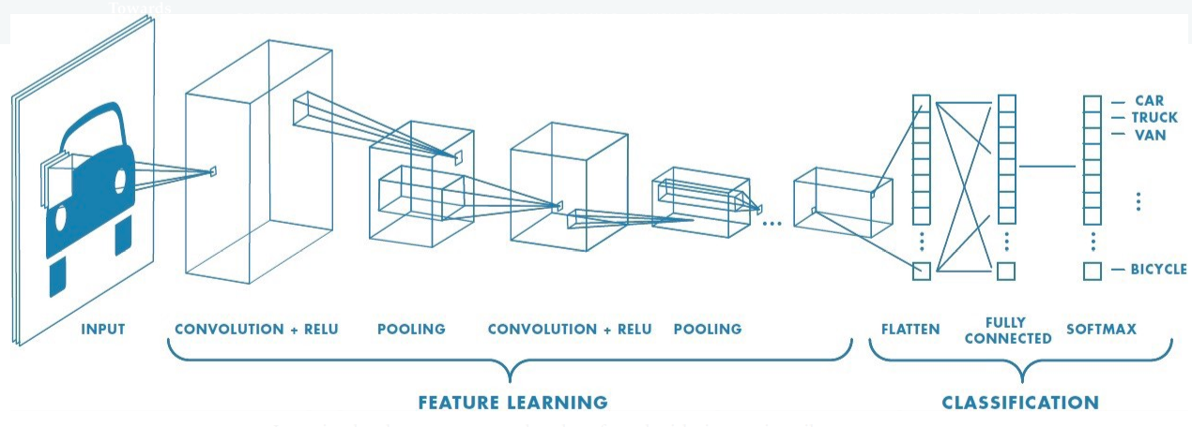
Convolutional Nueral Networks
Convolutional layer and pooling layer capture low level details of the images
Convolutional layer and pooling layer together form ith layers of a CNN.

Slide 12
Activation Function
•Activation functions are mathematical equations that determines the output of a neural network
•It normalize the output of each neuron to a certain range like tanh activation function normalizes between –1 to 1.
•Also known as Transfer function

Slide 13
Types of Activation Function
•Linear activation function
•Non-Linear activation function

Slide 14
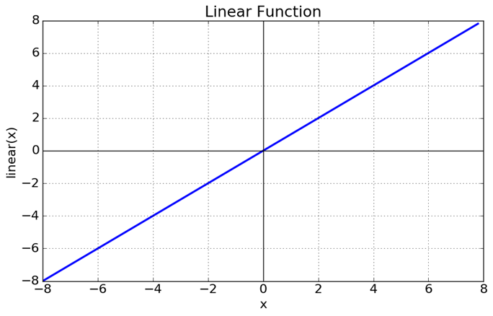
Linear activation function
•A straight-line function where activation is proportional to input
•It is of the form: A = cx
•Range : (-infinity to infinity)

Slide 15
Disadvantages of Linear activation function
• Not possible to use backpropagation (gradient descent) to train the model
• limited power and ability to handle complexity varying parameters of input data

Slide 16
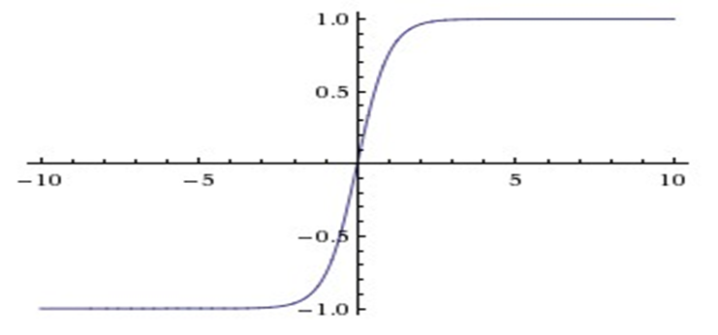
Non-Linear activation function
•Non-linear functions are those which have degree more than one and they have a curvature when we plot.
•It makes it easy for the model to generalize or adapt with variety of data.

Slide 17
Advantages of Non-Linear activation function
• allow backpropagation as it is differentiable.
• allow “stacking” of multiple layers of neurons to create a deep neural network.

Slide 18
Types of Non-Linear activation function
•Sigmoid function
•Tanh function
•ReLu function
•Leaky ReLu
•Softmax function

Slide 19
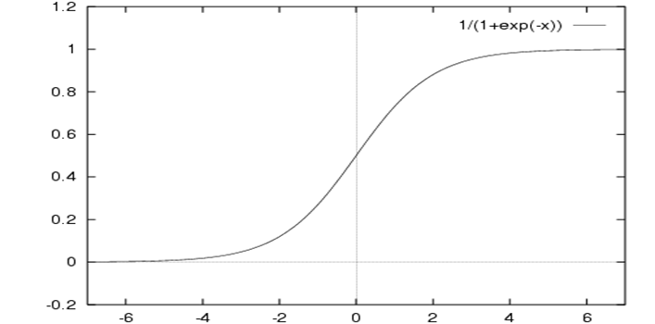
Sigmoid Function
•It is a activation function of form f(x) = 1 / 1 + exp(-x)
•Range (0,1)

Slide 20
Drawbacks of Sigmoid function
• Vanishing gradient problem
• It makes the gradient updates go too far in different directions
• Sigmoid have slow convergence.

Slide 21

Tanh function
• Tanh function is of the form is f(x) = 1 — exp(-2x) / 1 + exp(-2x)
_{•Range (-1,1)}
•Mostly used in classification problems

Slide 22
ReLu function
•In ReLU R(x) = max(0,x) i.e if x < 0 , R(x) = 0 and if x >= 0 , R(x) = x
•Most widely used activation function
•it avoids vanishing gradient problem
•it should only be used within Hidden layers of a Neural Network Model
•Sometimes ReLu could result in Dead Neurons called Dying ReLU Problem
•
•

Slide 23
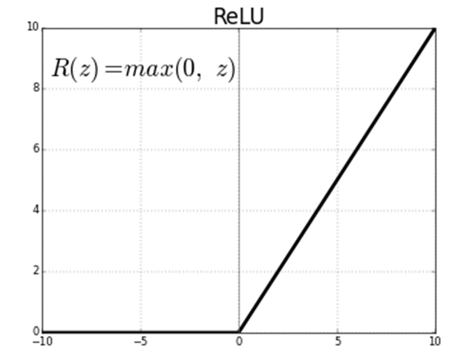

Slide 24
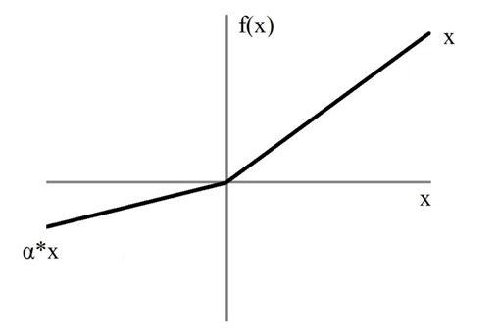
Leaky ReLu
•an improved version of the ReLU function
•Leaky ReLu fixs the problem of dying neurons
•Range (-infinity, infinity)

Slide 25
Softmax function
•normalizes the outputs for each class between 0 and 1
•classify inputs into multiple categories
•Used only in output layer

Slide 26
Questions
•Which is the best activation function?
•How to choose activation function in the neural network?

Slide 27
Use cases
Sigmoid function: This activation function is used when we are doing Binary Classification modeling.
Hyperbolic tan Function: Tanh function is mostly used in recurrent neural network for natural language processing and speech recognition task.
ReLU Function: This activation function eliminates the vanishing gradient problem. So, mostly used in the hidden units of deep neural network. Also, used in the output layer of the network which are used for object classification and speech recogition application.

Slide 28
Loss Functions for Neural Networks
Loss function helps in optimizing the parameters of the neural networks.
Our objective is to minimize the loss for a neural network by optimizing its parameters(weights).
The loss is calculated using loss function by matching the target(actual) value and predicted value by a neural network.
we use the gradient descent method to optimize the weights of the network such that the loss is minimized.

Slide 29
Different Loss Functions
Mean squared Error(L2 Loss)
Cross Entropy Loss
L1 Loss

Slide 30

Mean squared Error (L2 Loss)
Mean squared error is the most common loss function in machine learning
The formula is :
MSE is the straight line between two points in Euclidian space
In neural network, we apply back propagation algorithm to iteratively minimize the MSE

Slide 31

Cross Entropy Loss
Cross entropy loss is a another common loss function that commonly used in classification or regression problems
Cross entropy is more advanced than mean squared error
the induction of cross entropy comes from maximum likelihood estimation in statistics.
The formula of cross entropy is:
Where y′i is the ground truth label of iith training instance and yi is the prediction result of your classifier for the iith training instance.

Slide 32
Binary Crossentropy
Used when you have a binary classification task
Using BCE loss function,just needs one output node to classify the data into two classes.
The output value should be passed through a sigmoid activation function so the output is in the range of (0–1).

Slide 33
Categorical Crossentropy
Used when you have a multi-class classification task
Using CCE loss function, there must be the same number of output nodes as the classes
The final layer output should be passed through a softmax activation so that each node output a probability value between (0–1).

Slide 34
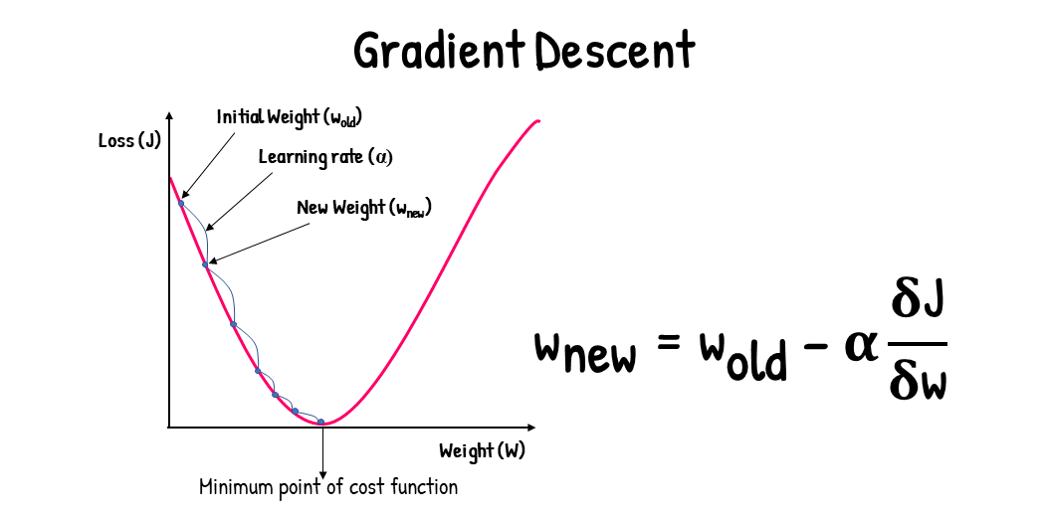
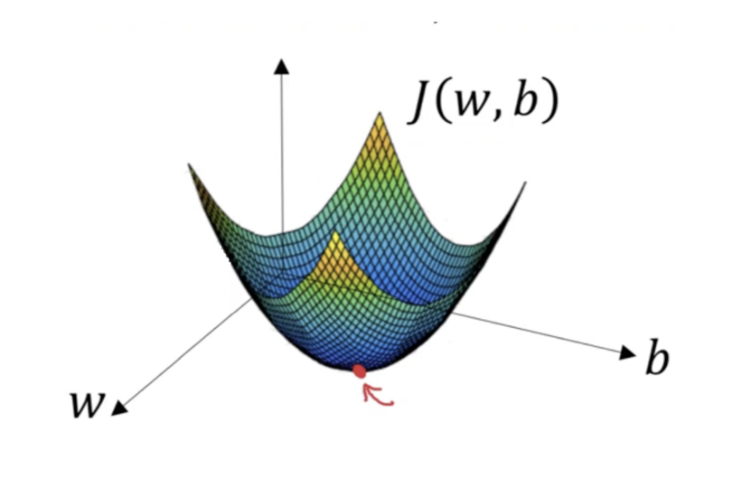
Gradient Descent
Gradient Descent is an optimization algorithm for finding a local minimum of a differentiable function.

Slide 35
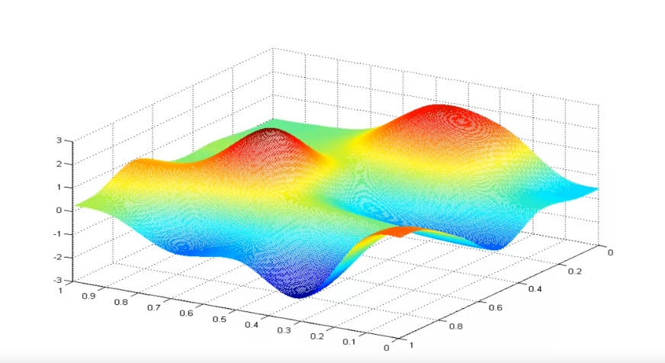
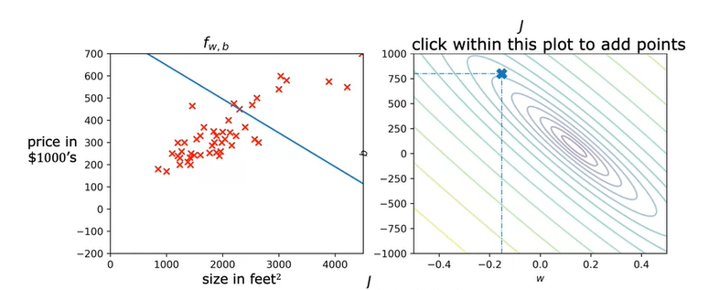
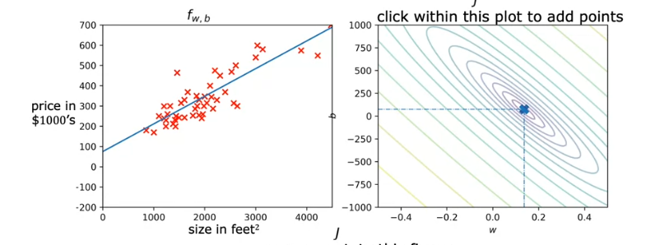
Gradient Descent Visualization
J
W
b

Slide 36
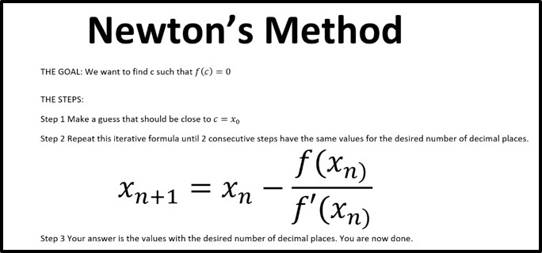
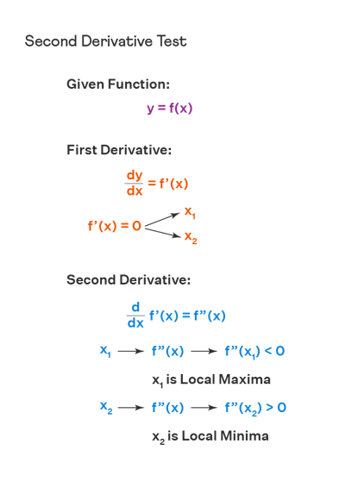
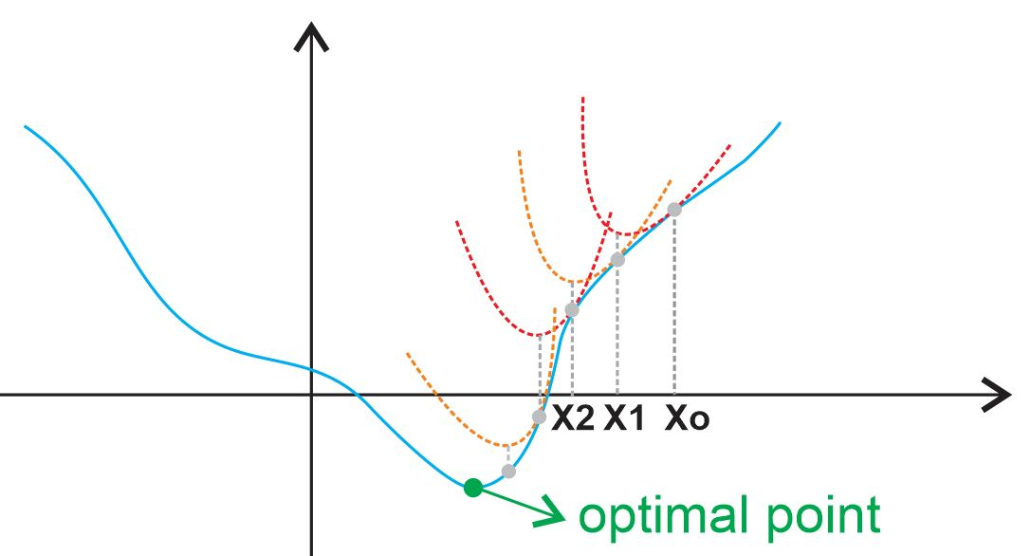

Slide 37
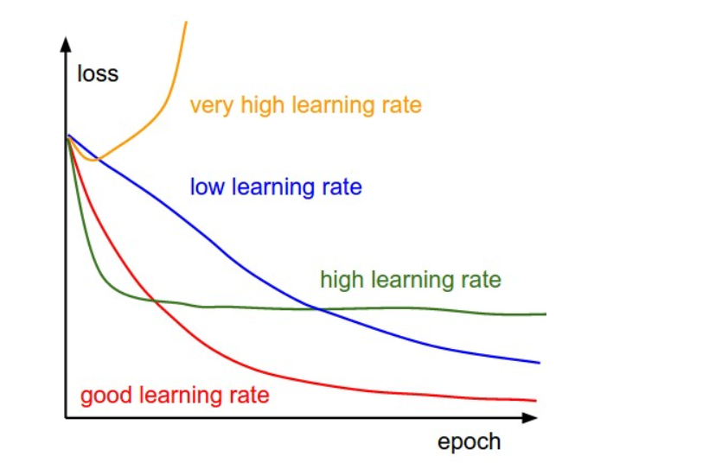
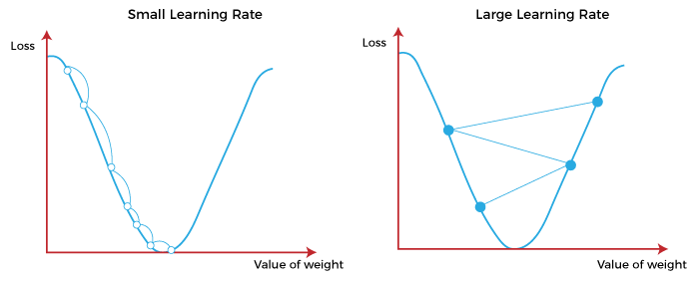
Learning Rate

Slide 38
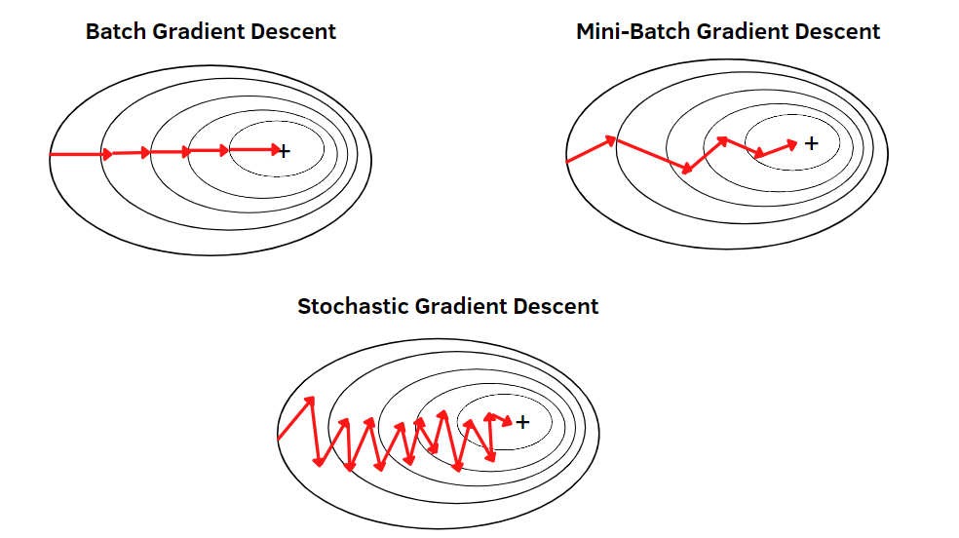
Gradient Descent Types

Slide 39
Back Propagation
Feed the input and compute the output
Calculate error
Take the error and propagate backward tuing the weights

Slide 40
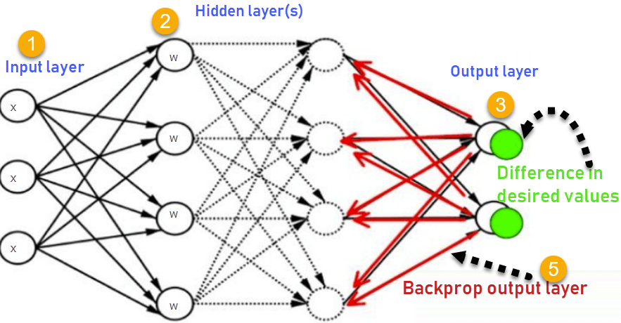
Back Propagation

